Slide 1
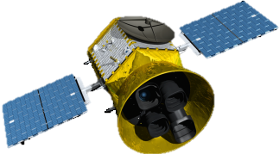
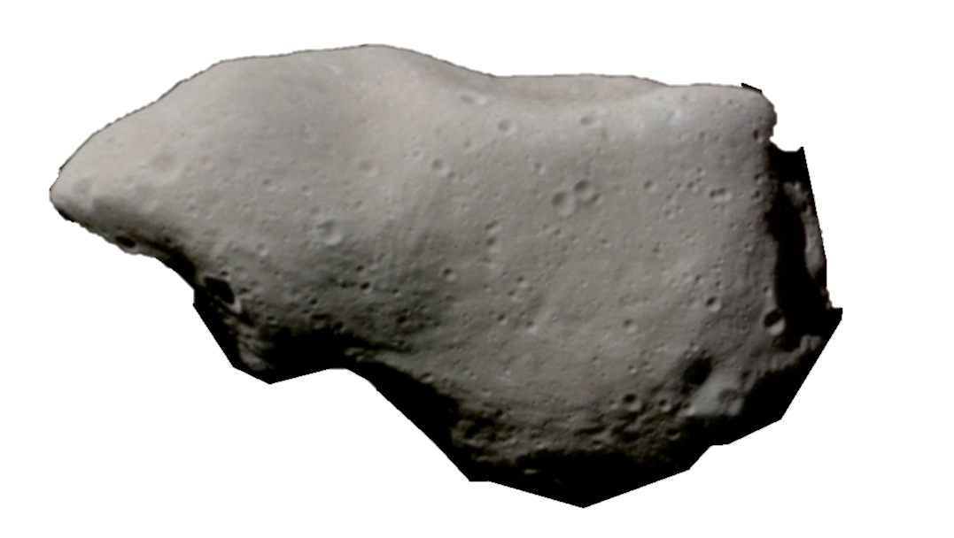

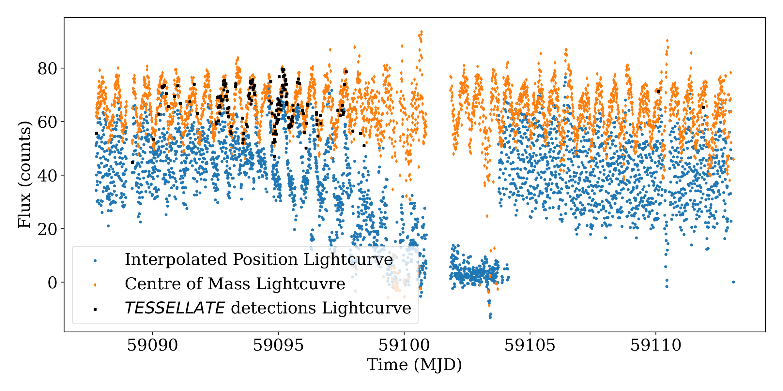
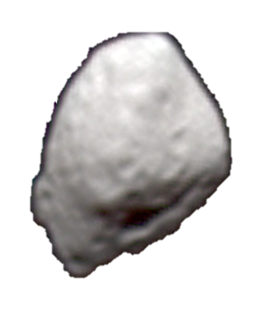
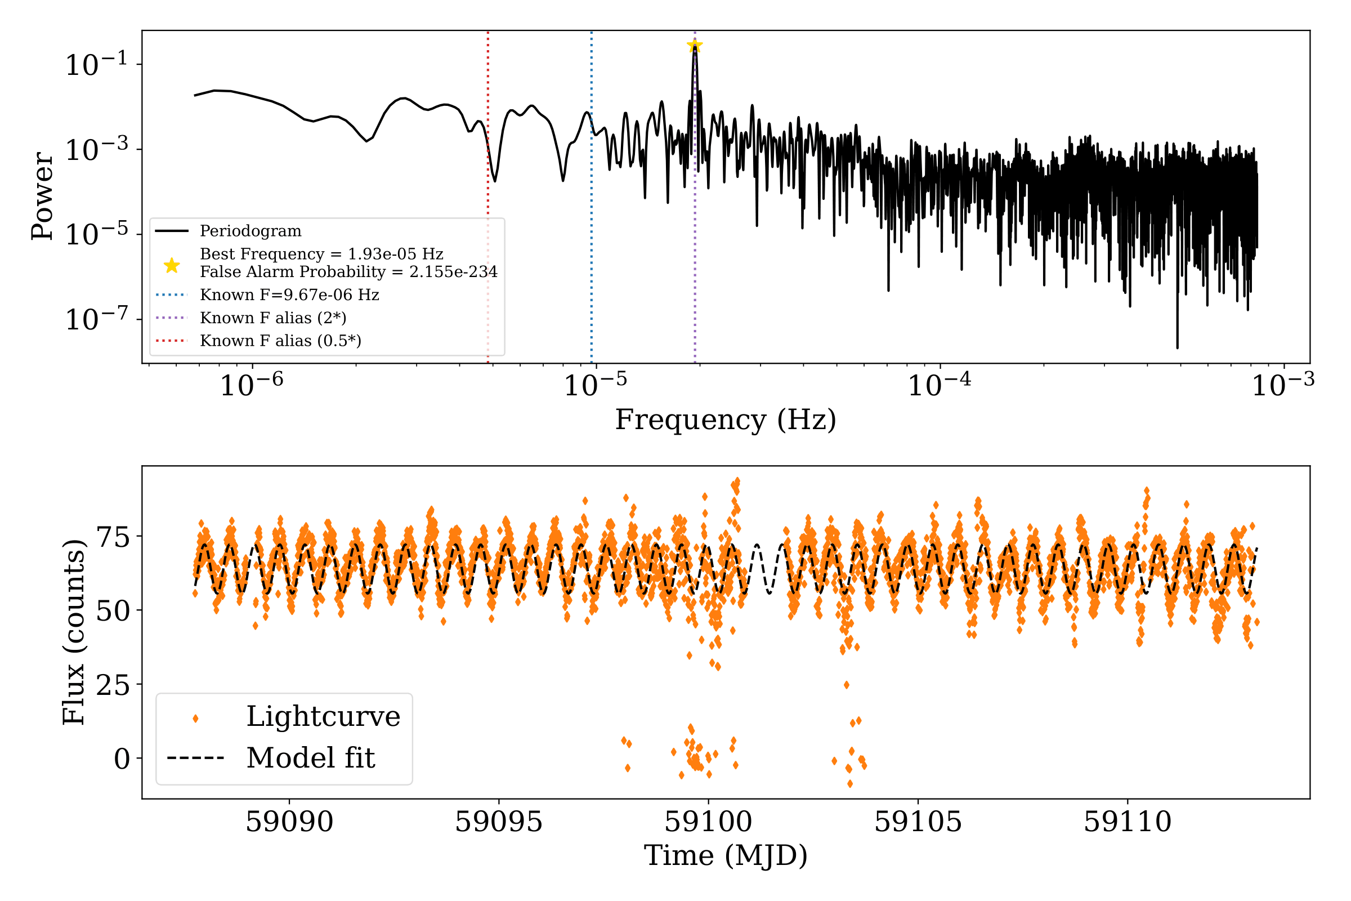
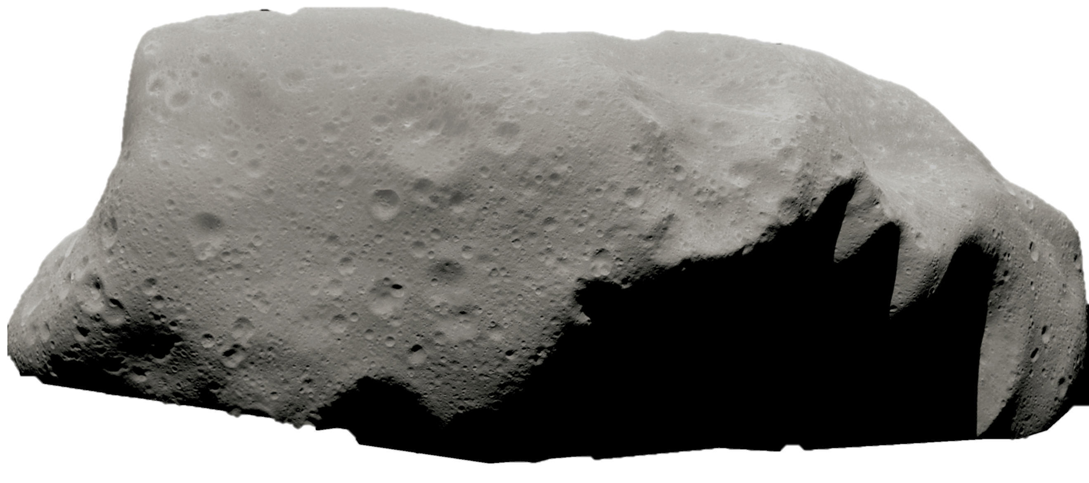
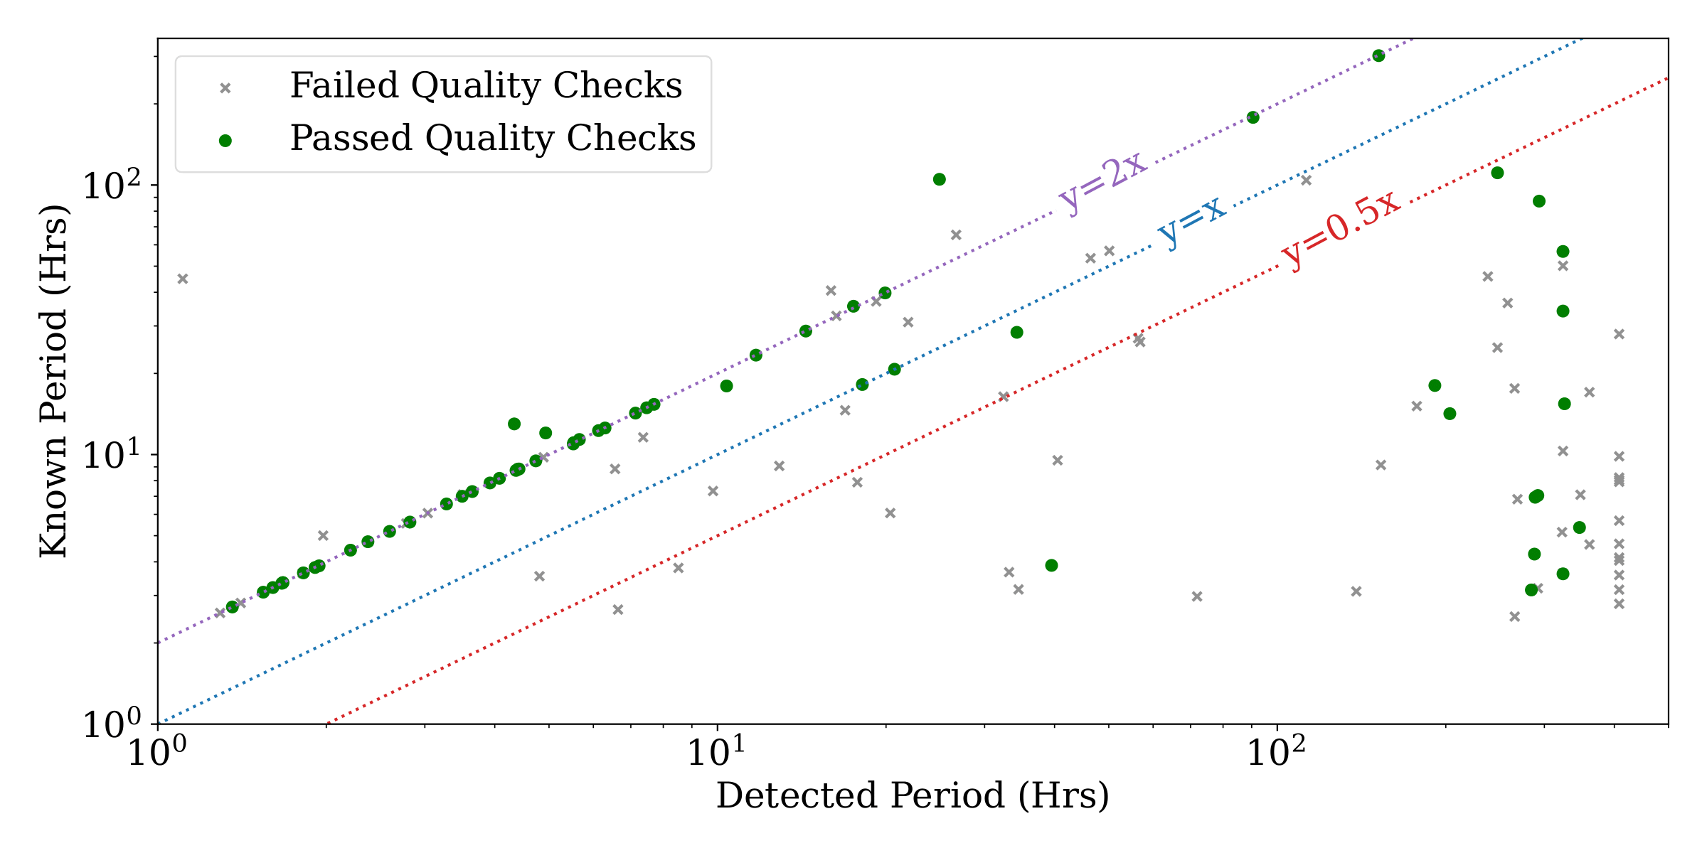
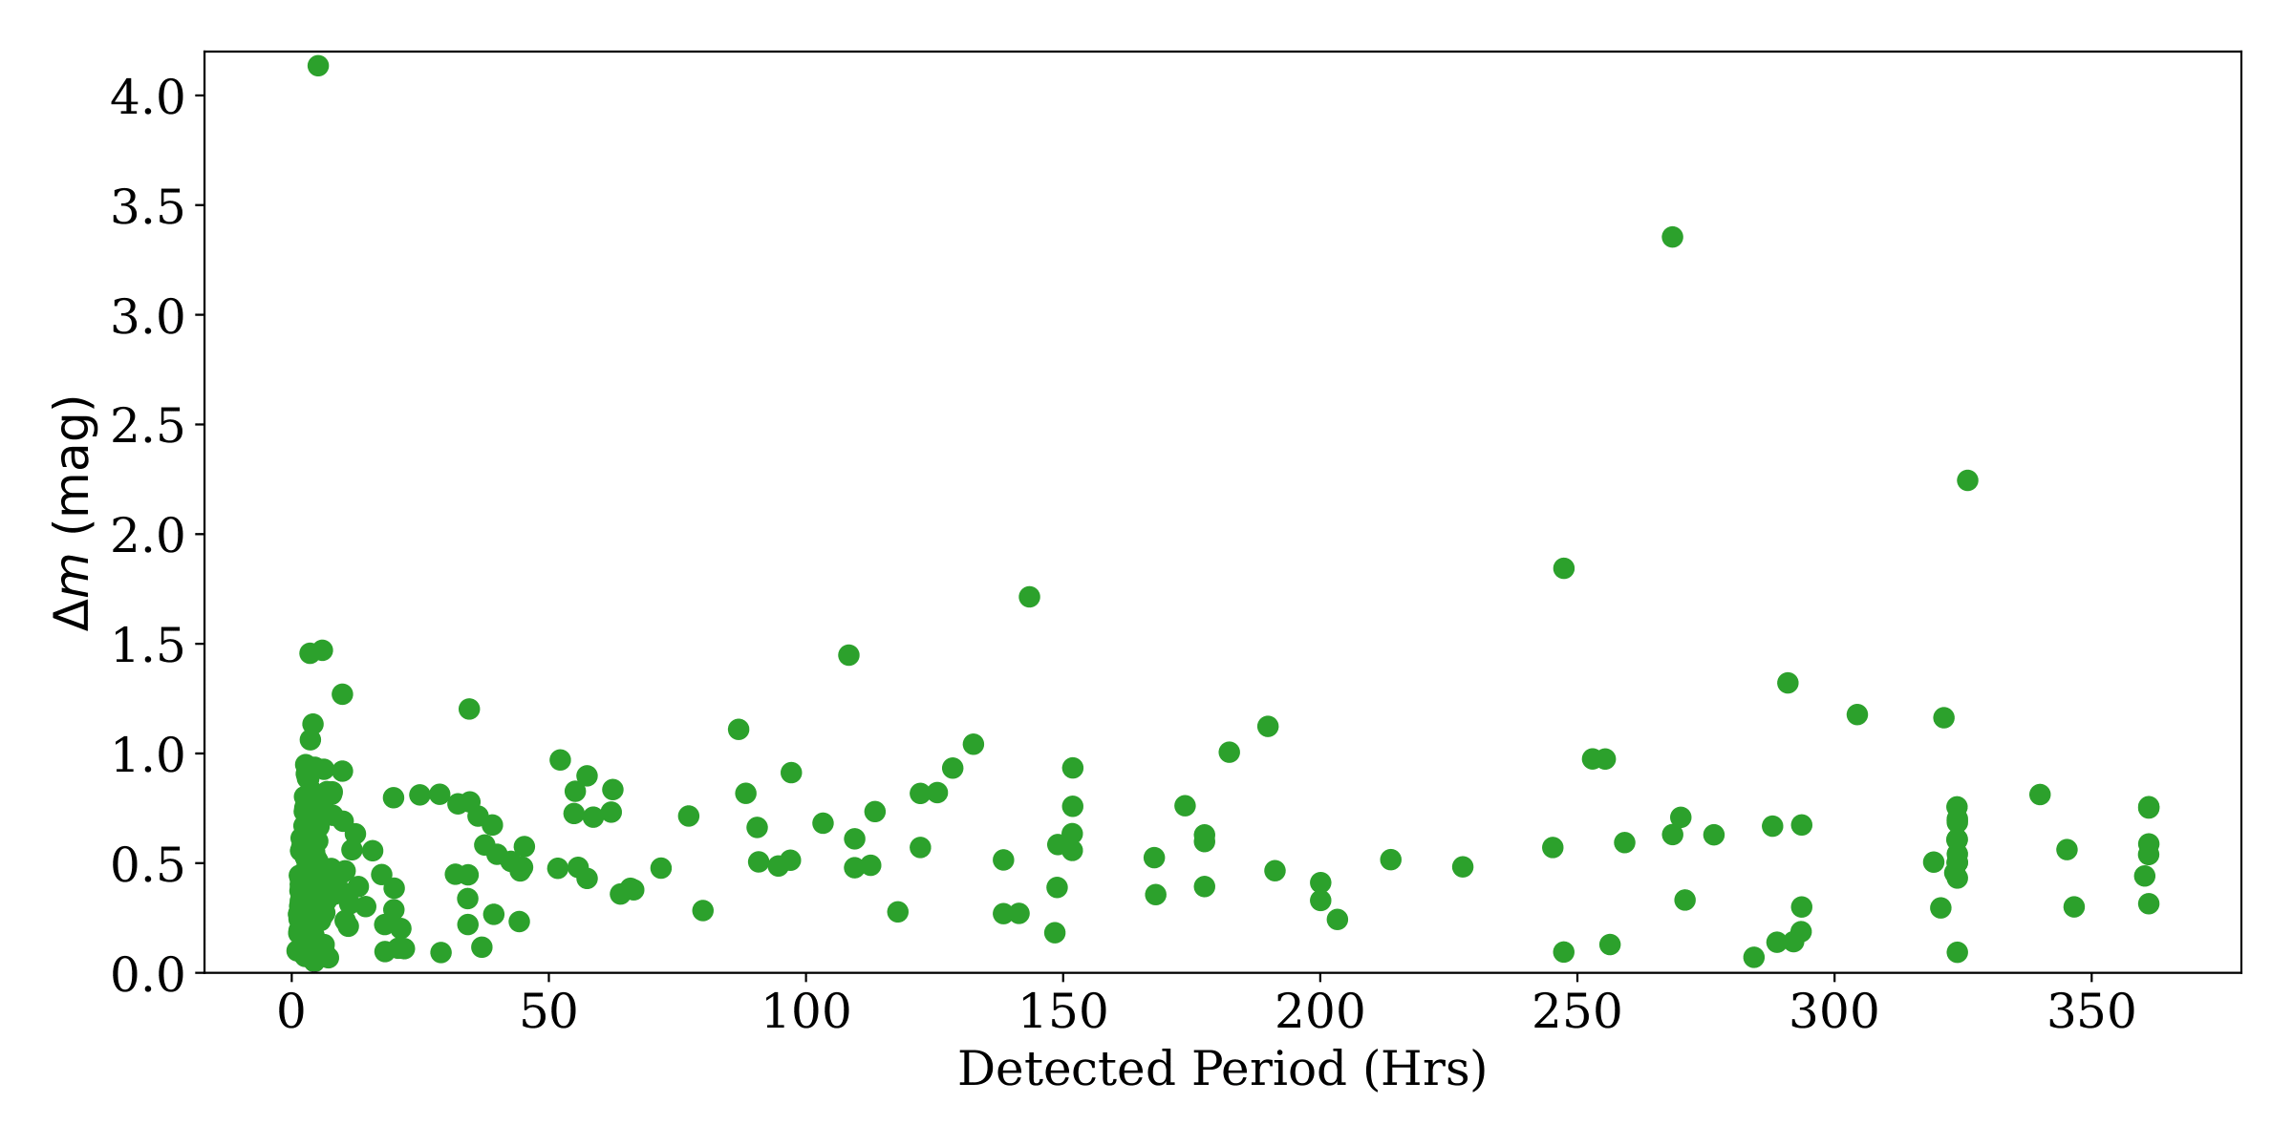
[1]
[2]
Detecting asteroid lightcurves and calculating periodograms with TESSELLATE.
Figure 1: Lightcurves of the asteroid (5254) Ulysses for the interpolated positions (blue), centre of mass positions (Orange) and TESSELLATE detection matches (black).
TESS can give accurate asteroid rotation periods.
Figure 2: Upper Panel: An example periodogram of the same asteroid. Lower Panel: The model fit to the lightcurve.
Figure 3: Comparison of detected period and known period for all the asteroids in the field and the Lightcurve Database (LCDB [3]) (grey), and those that passed the quality checks (green).
The amplitude of variation is constant with rotation period.
Figure 4: Detected periods against the amplitude variation of all the asteroids that pass the quality checks.
References:
[1] G.R. Ricker et al. (2014), JATIS,1, 1
[2] https://www.planetary.org/space-images/asteroids-and-comets-color-2014
[3] B.D. Warner et al. (2009), Icarus, 202, 134
Brayden Leicester Supervisors: Ryan Ridden-Harper and Michele Bannister

